Slide 1
Why?
General speech science goals: how do people speak?
Path towards better training materials, iterative training processes
SweTerror: multidisciplinary investigation into parliamentary discourse around the topic of terrorism

Slide 2
Fun personal fact:
I come from Ireland, home of what used to be the world’s best known terrorist organisation.

Slide 3


Slide 4
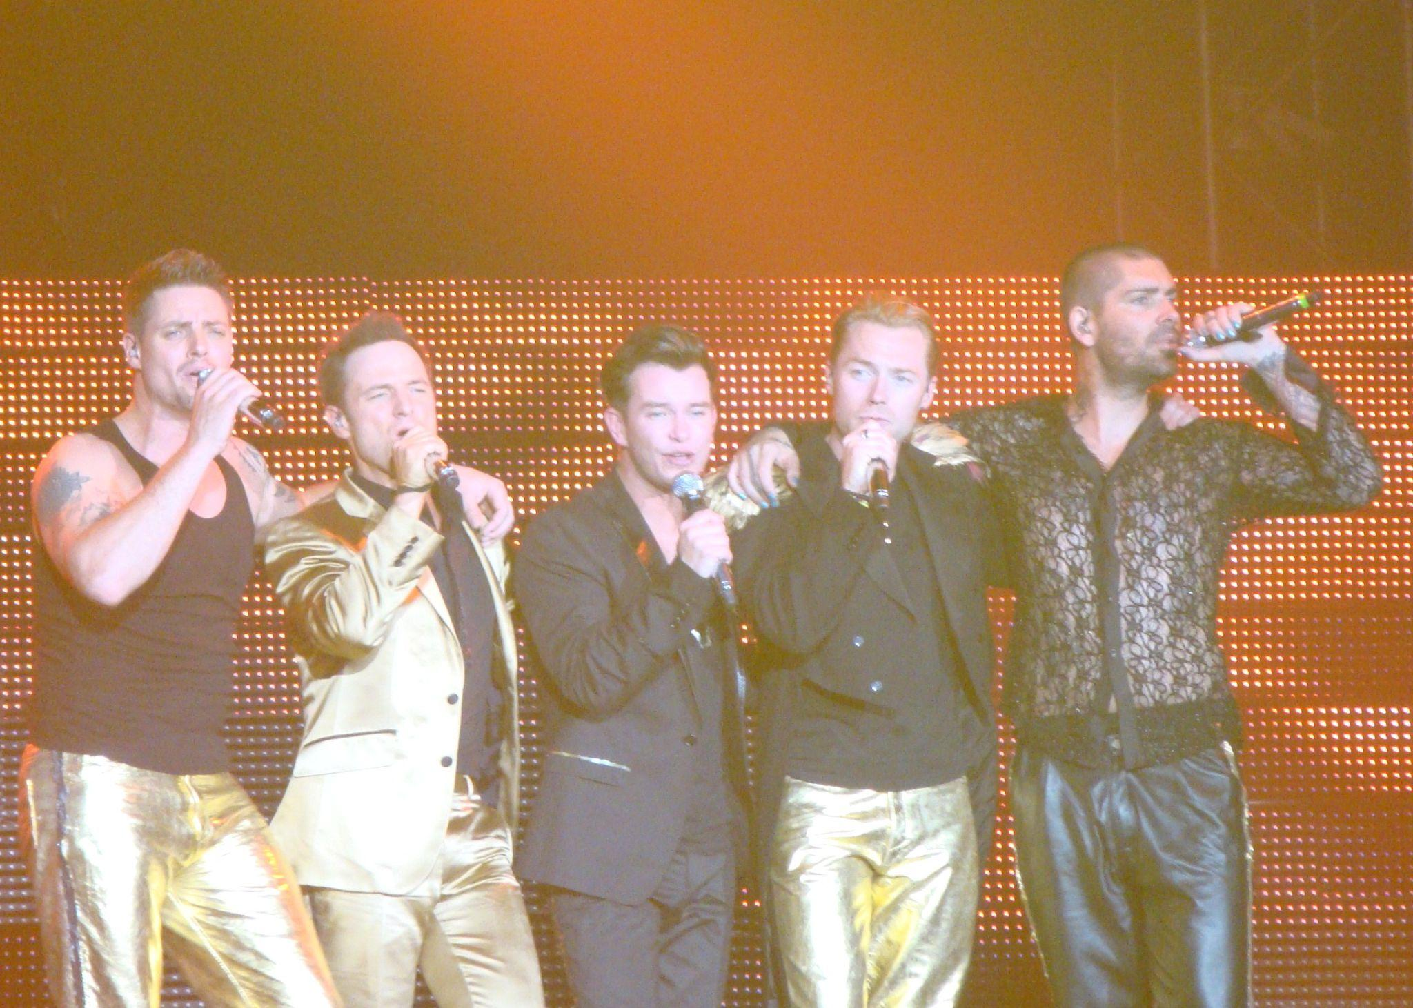
Boyzone

Slide 5
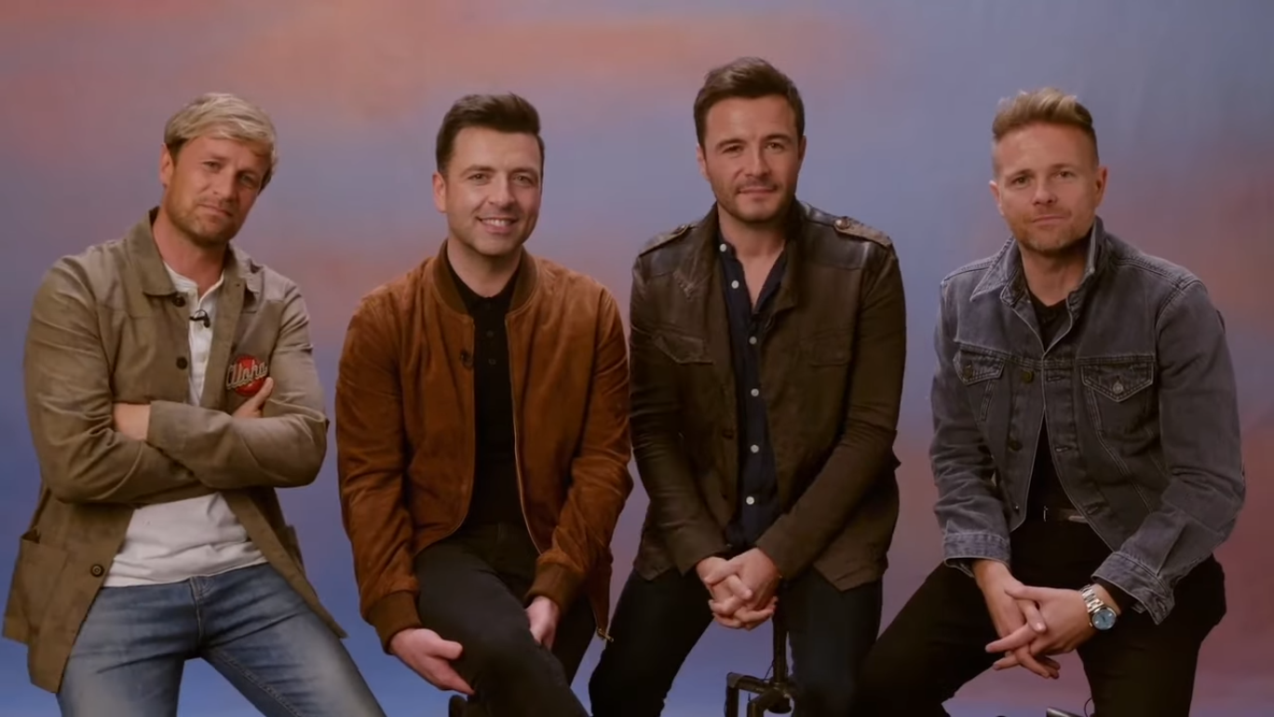
Westlife

